Slide 1

ROGUE AI
Project Id: SE38

Slide 2



Team
M. Humza Butt
Maha Muzammil
Sh.Umer Saeed
FA17-BSE-011
FA17-BSE-071
FA17-BSE-038

Slide 3
Game AI vs AI
Attributes exist
in Object Memory
Addresses
Dataset
Models
Prediction

Slide 4
Introduction
Rogue AI aims to be the warfare of Human vs Robots with the chain of puzzles to be solved to achieve the goal and a sci-fi story line

Slide 5

Skill improvement
Goals
&
Objectives
To improve the logical skills of the player
Goal to achieve
To defeat the enemies and to recover the chip
Behavioural modelling
To make logical skills of the person a part of his survival instincts by making him undergo various challenges

Slide 6
Problem Statement
Only for fun
Waste of time
Addiction

Slide 7
Our Approach
Our game is basically a mix of fun and learning. The game is specifically designed in a way that a user will be able to build his logical sense by solving logical puzzle along with having fun.

Slide 8

Motivation
The core motivation for this game is to persuade the user to think logically in adrenaline conditions. It will put the user in a situation to make faster and logical decisions for his survival.
In a nutshell, this game will serve the purpose of providing fun along with polishing the spatial skills of the user.

Slide 9
Scope
Mechanical Needs
Aesthetics Needs
7 out of 10
8 out of 10

Slide 10
Continue...
Story Needs
Technology
3 out of 10
5 out of 10

Slide 11



Review of Goals
DONE
ONGOING
01
02
03
PROJECT BEGIN
REQUIREMENT ANALYSIS
DEVELOPMENT PHASE 1
Groundwork.
Raw plan doc.
Rough system sketch.
Requirement analysis
Elicitation
Selecting final requirements
R & D
Assets collection
Building models
Scripting
Documenting

Slide 12
Continue...
DONE
ONGOING
04
05
06
DEVELOPMENT PHASE 2
FINAL REPORT
PRESENTATION
Puzzles finding
Puzzles integration
Levels other than the base
Game map(updation)
Report submission
Report-II
Presentation

Slide 13
Software Design Model

Slide 14
Exploratory Model
Specification
Initial Version
Intermediate Version
Development
Validation
Final
Version

Slide 15
System Design

Slide 16
WBS
Rogue AI
Closeout
Initiation
Game Design
Production
Testing
Defining Goals
Assign Roles
Access Feasibility
Coding
Process improvement
Black box
White box
Documentation Handover
Presentation
Documentation
Proposal
SRS
SDD
Models
Game World
Graphics
Game play
Game Progression
Mission/challenge Structure
Puzzle Structure
Objectives
Play Flow
Mechanics
Physics
Movement
Objects interaction
Combat
Screen Flow
Characters
Levels
Interface
Visual System
Control System
Artificial Intelligence
Enemy AI
Technical
Target hardware
Game Art
Key assets
Scheduling
Budgeting
modeling
texture
animation
Graphics
Integration
Unit
Integration
Research
Project plan
Goals
Milestones

Slide 17
Activity Diagrams

Slide 18
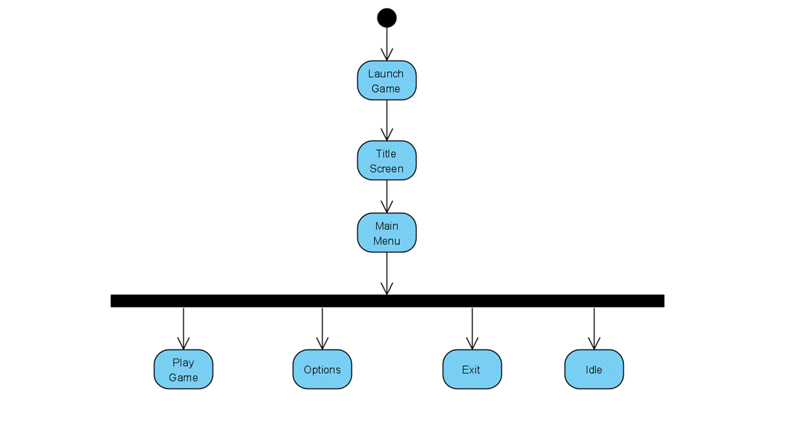
Launch game

Slide 19
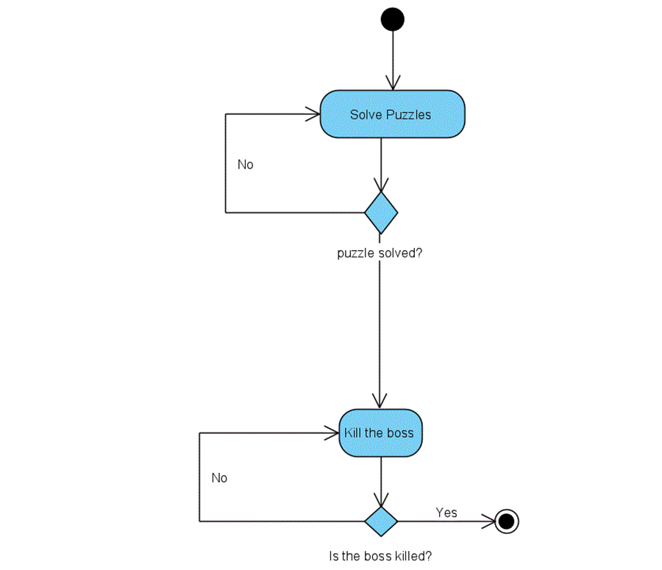
In game

Slide 20
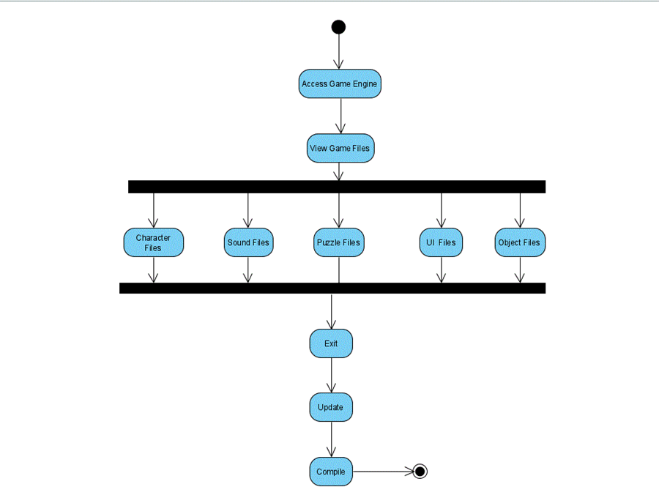
Update game

Slide 21
Sequence Diagrams

Slide 22
Play game

Slide 23
Update game

Slide 24
Progress

Slide 25
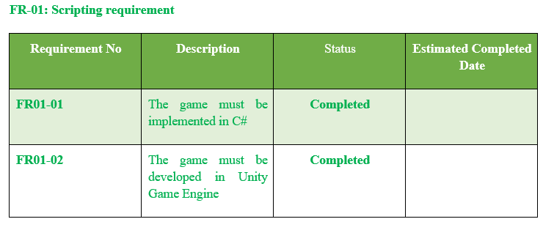
Functional Requirement Status

Slide 26
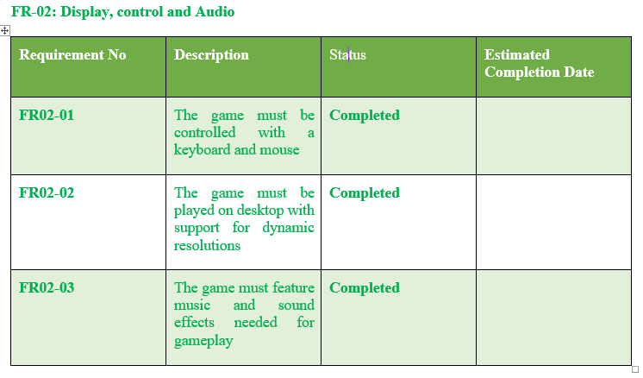
Continue…

Slide 27
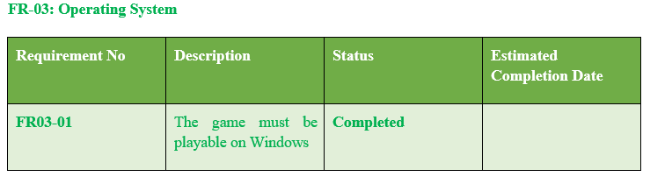
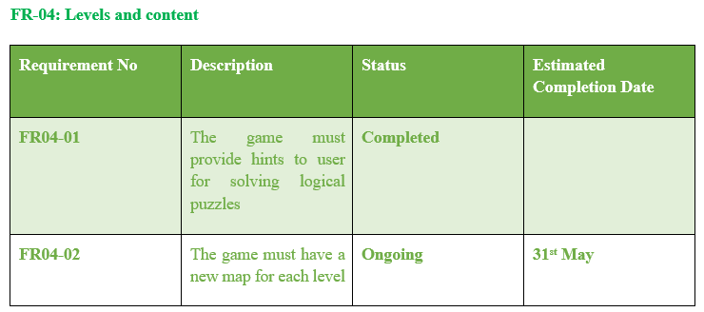
Continue…

Slide 28
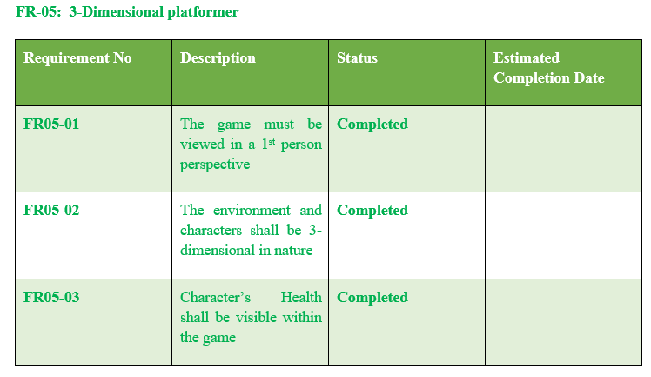
Continue…

Slide 29
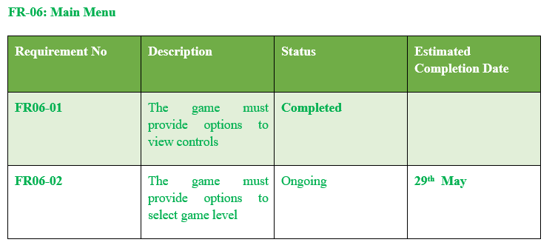
Continue…

Slide 30
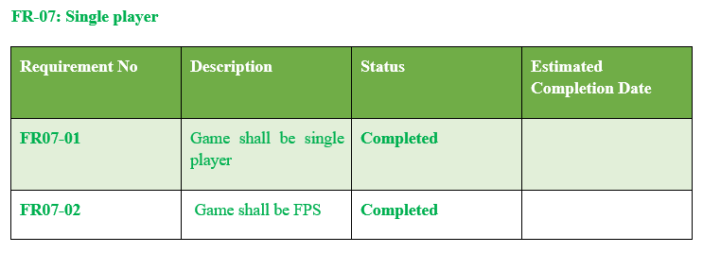
Continue…

Slide 31
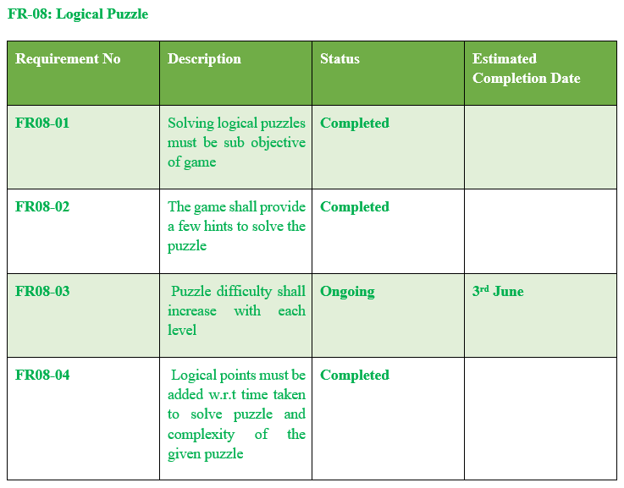
Continue…

Slide 32
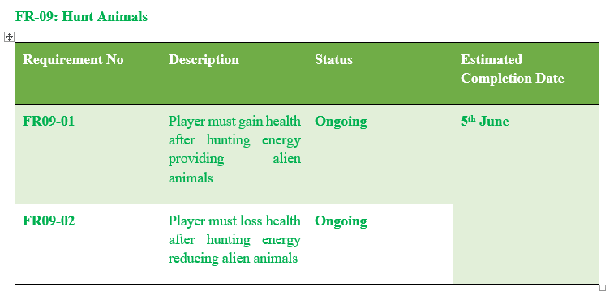
Continue…

Slide 33
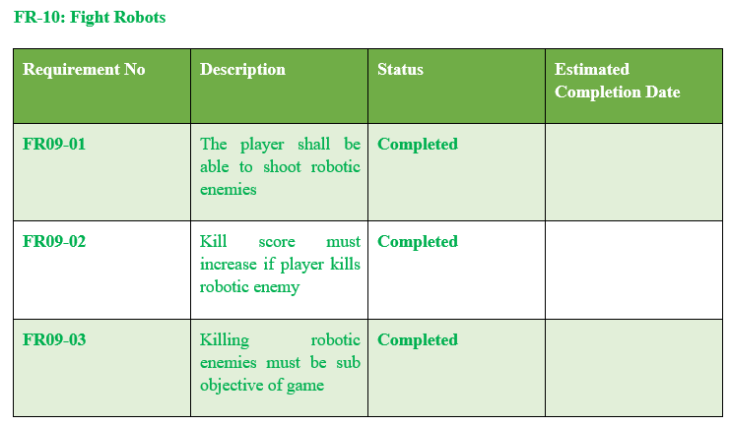
Continue…

Slide 34
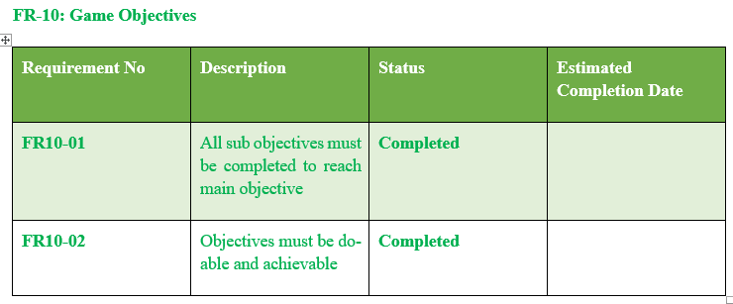
Continue…

Slide 35
Continue…

Slide 36
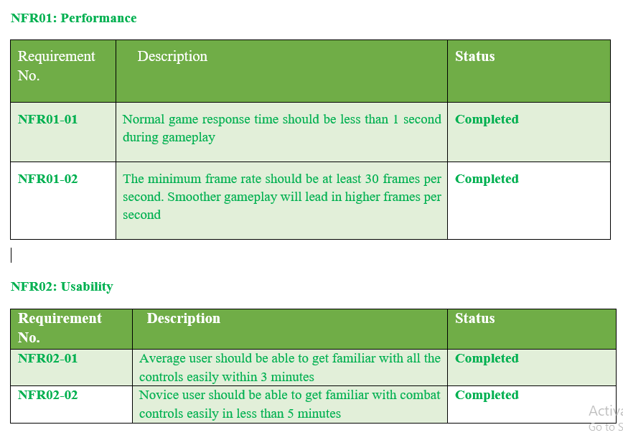
Non-Functional Requirement Status

Slide 37
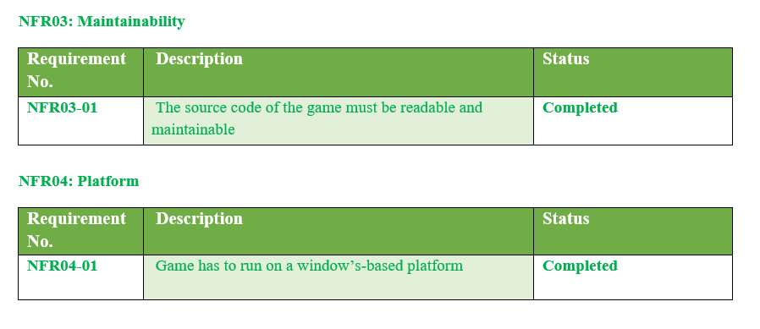
Continue…

Slide 38
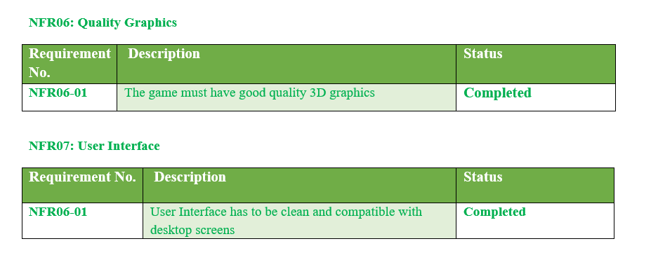
Continue…

Slide 39
Continue…

Slide 40
End

